Slide 1


FOUNDATION OF GROUP BEHAVIOR

Slide 2
To discuss:
3.1. Defining teams and/or groups
3.2. Classifying teams and/or groups
3.3. Why do people form and/or join teams/groups?
3.4. Stages in team/group development
3.5. Obstacle to team /group productivity
3.6. Increasing team/group productivity
3.7. Group behavior
3.8. Implication for performance and satisfaction

Slide 3

What is a group?
A group is two or more people having a unifying relationship, such as common objectives or physical proximity.
Basic features:
Two or more persons
Interaction
Reasonable size
Shared goals
Collective identity
Group dynamics

Slide 4
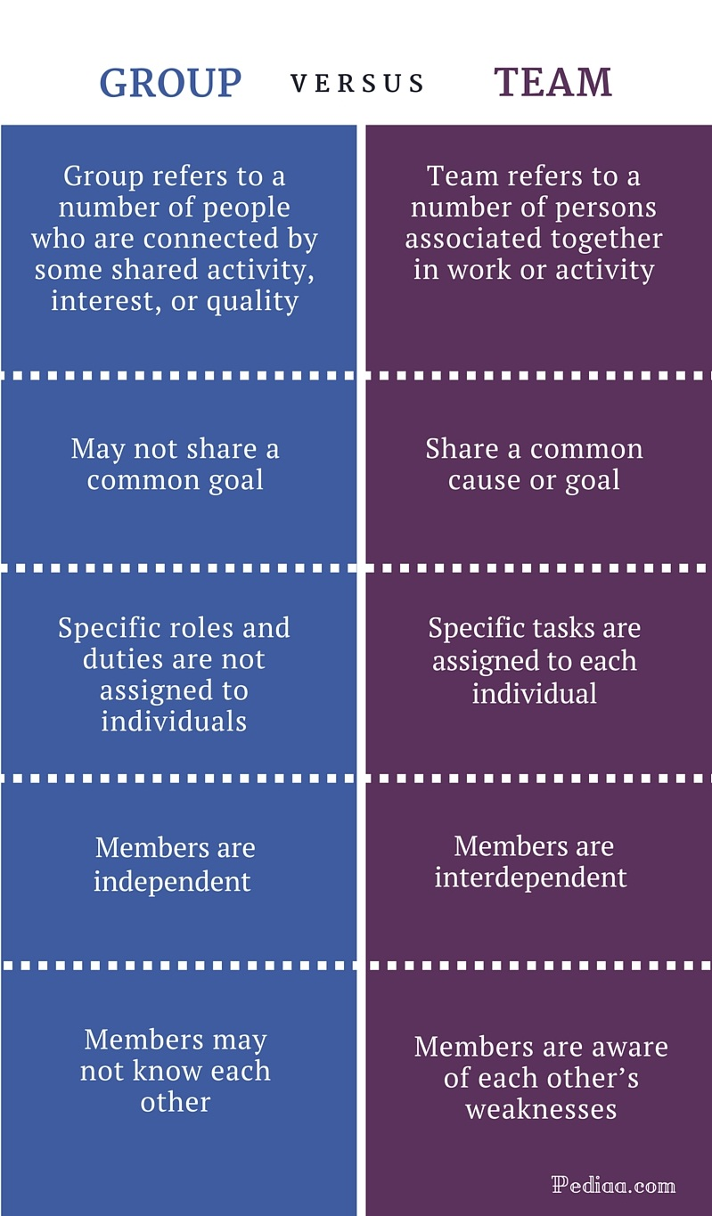
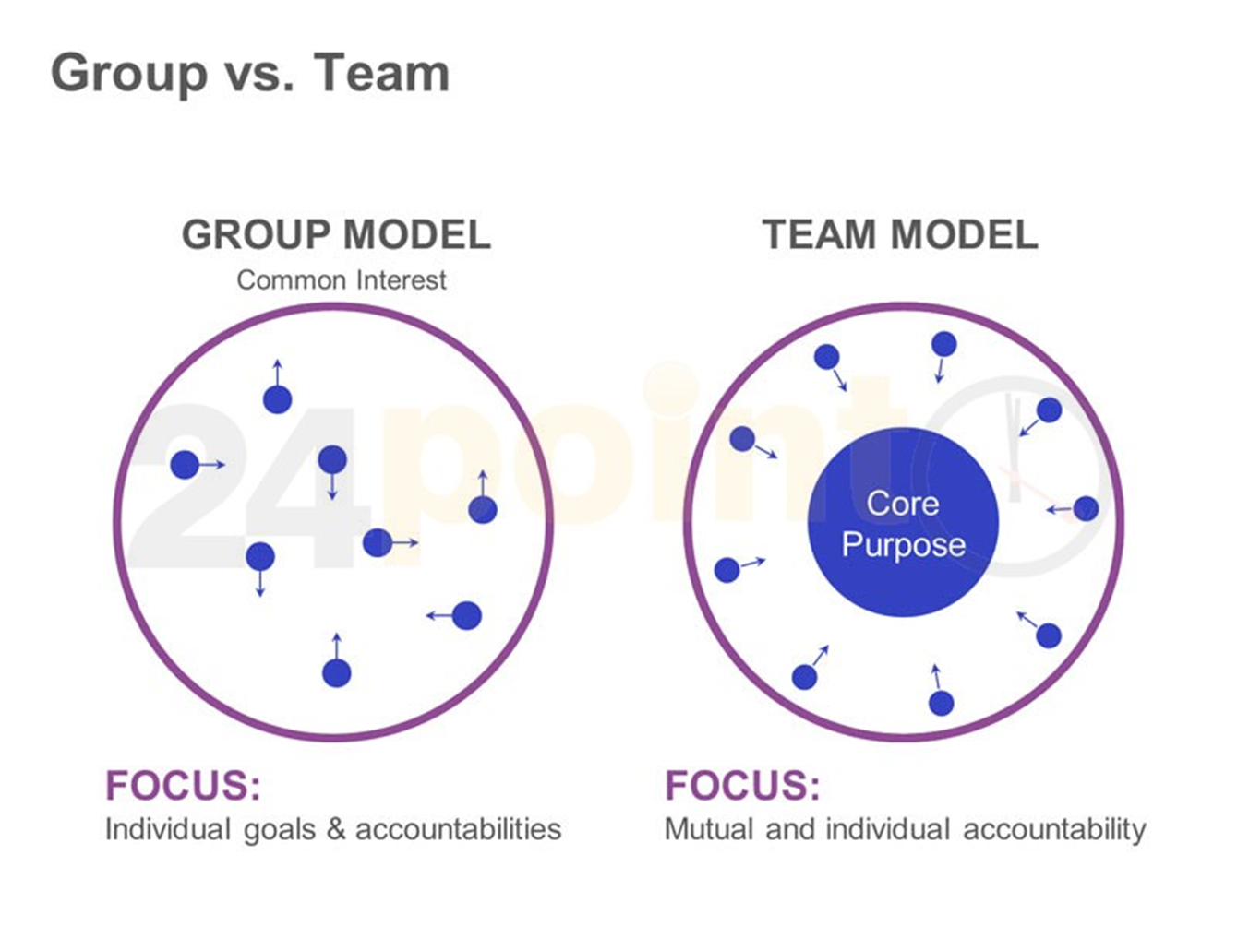

Slide 5
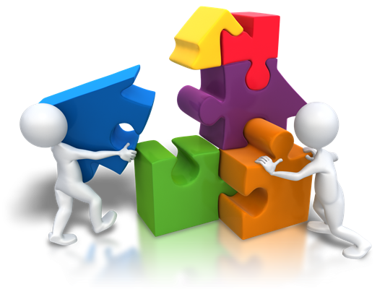
Types of groups:
Formal groups
Command groups
Cross functional teams
Task forces
Self managed teams
Informal groups
Interest groups
Friendship groups

Slide 6
Why People Join Groups

Slide 7

Stages of Group Development
Prestage I
Stage I
Forming
Stage II
Storming
Stage III
Norming
Stage IV
Performing
Stage V
Adjourning

Slide 8
Group Behavior Model
Group
Member
Resources
Group
Task
External
Conditions
Group
Processes
Performance
and
Satisfaction
Group
Structure

Slide 9

External Conditions
Imposed on the Group
Overall strategy
Authority structures
Formal regulations
Resources
Employee selection
Evaluation-rewards
Culture
Work setting

Slide 10
The Resources
of Group Members
Knowledge,
Skills, and
Abilities
Personality
Characteristics

Slide 11

Identity
Expectations
Group
Roles
Conflict
Perception

Slide 12
Performance
Appearance
Group
Norms
Resources
Arrangement

Slide 13
Status in the Group
Norms
Equity
Culture

Slide 14
Size of the Group
Small groups
Large groups
Social loafing
Individual effort

Slide 15
The Composition
of the Group
Diversity
Demography
Cohorts

Slide 16

Cohesiveness-Productivity Relationship
Cohesiveness
High
Low
High
Productivity
Moderate
Productivity
High
Performance Norms
Low
Productivity
Moderate to Low
Productivity
Low

